Slide 1



AI Master Class series – Day 18
Vehicle Detection

Slide 2
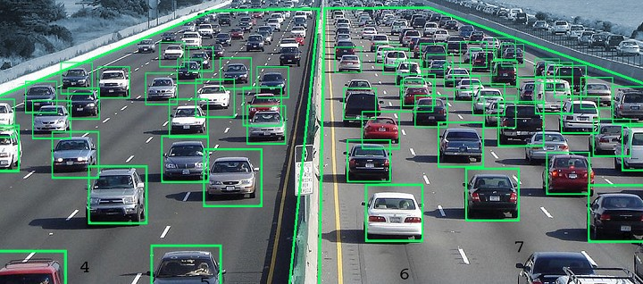
Vehicle detection system.
Vehicle detection plays an important role in safe driving assistance technology.
Smart Traffic light system
For every frame:
Detect potential regions of interest
Filter detected regions based on vertical & horizontal similarity
If its a new region, add to the collection
Clear collection every 30 frames

Slide 3
Block Diagram – Workflow of Vehicle detection system.
Loading HaarCascade
Algorithm
Initializing Camera
Reading Frame from Camera
Converting Color image into Grayscale Image
Obtaining Car coordinates by passing algorithm
Drawing Rectangle on the Car Coordinates
Display the output Frame

Slide 4

! PRACTICAL SESSION !
Vehicle detection

Slide 5
import cv2
import imutils
cascade_src = 'cars.xml'
car_cascade = cv2.CascadeClassifier(cascade_src)
cam=cv2.VideoCapture(1)
try:
while True:
detected = 0
ret,img=cam.read()
img=imutils.resize(img,width=300)
gray = cv2.cvtColor(img, cv2.COLOR_BGR2GRAY)
cars = car_cascade.detectMultiScale(gray, 1.1, 1)
for (x,y,w,h) in cars:
cv2.rectangle(img,(x,y),(x+w,y+h),(0,0,255),2)
cv2.imshow("Frame", img)
b=str(len(cars))
a= int(b)
detected=a
n=detected
print("------------------------------------------------")
print ("North: %d "%(n))
if n>=2:
print ("North More Traffic")
else:
print ("no traffic")
if cv2.waitKey(33) == 27:
break
except KeyboardInterrupt:
cv2.destroyAllWindows()

Slide 6

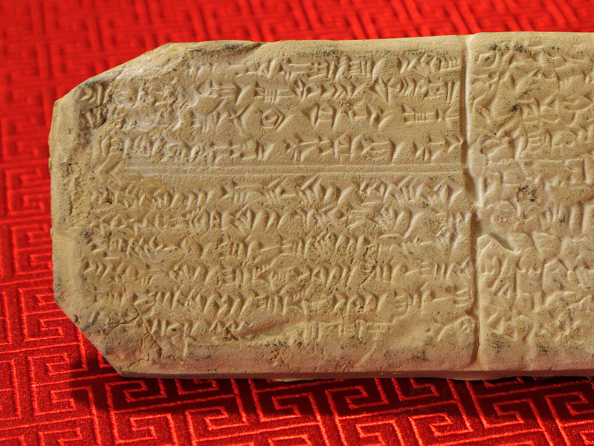
AI News – Day 18. 2020
System developed at MIT CSAIL aims to help linguists decipher languages that have been lost to history.
MIT’s Computer Science and Artificial Intelligence Laboratory (CSAIL) recently made a major development in this area: a new system that has been shown to be able to automatically decipher a lost language, without needing advanced knowledge of its relation to other languages.
The team’s ultimate goal is for the system to be able to decipher lost languages that have eluded linguists for decades, using just a few thousand words.

Slide 7
Thanks!
Tomorrow session
Personal Feedback:
LinkedIn - Link in Description
https://www.linkedin.com/in/sanjay-kumar-a-p-4447801a5/
www.pantechsolutions.net
License plate recognition

Slide 8
Day-18 Agenda.
01.
02.
03.
Vehicle Detection
Workflow
Vehicle Detection & Tracking
04.
Q & A

